Slide 1
Student INFORMATION SYSTEM
Mentor : Manjunath Mattam
IH201585025-Venkatesh.E IH201585028-Sai Manjunath.G
IH201585069-Manoj.P IH201585094-Tarun.V

Slide 2
Existing
Ambiguity in grades
No proper privileges for users
No provision of student generated transcripts through E-mail.
PRESENT
Grading is properly enhanced for future use also
Proper privileges for users
Provision of student generated transcripts through E-mail.
Buttons on Landing page were properly organized

Slide 3
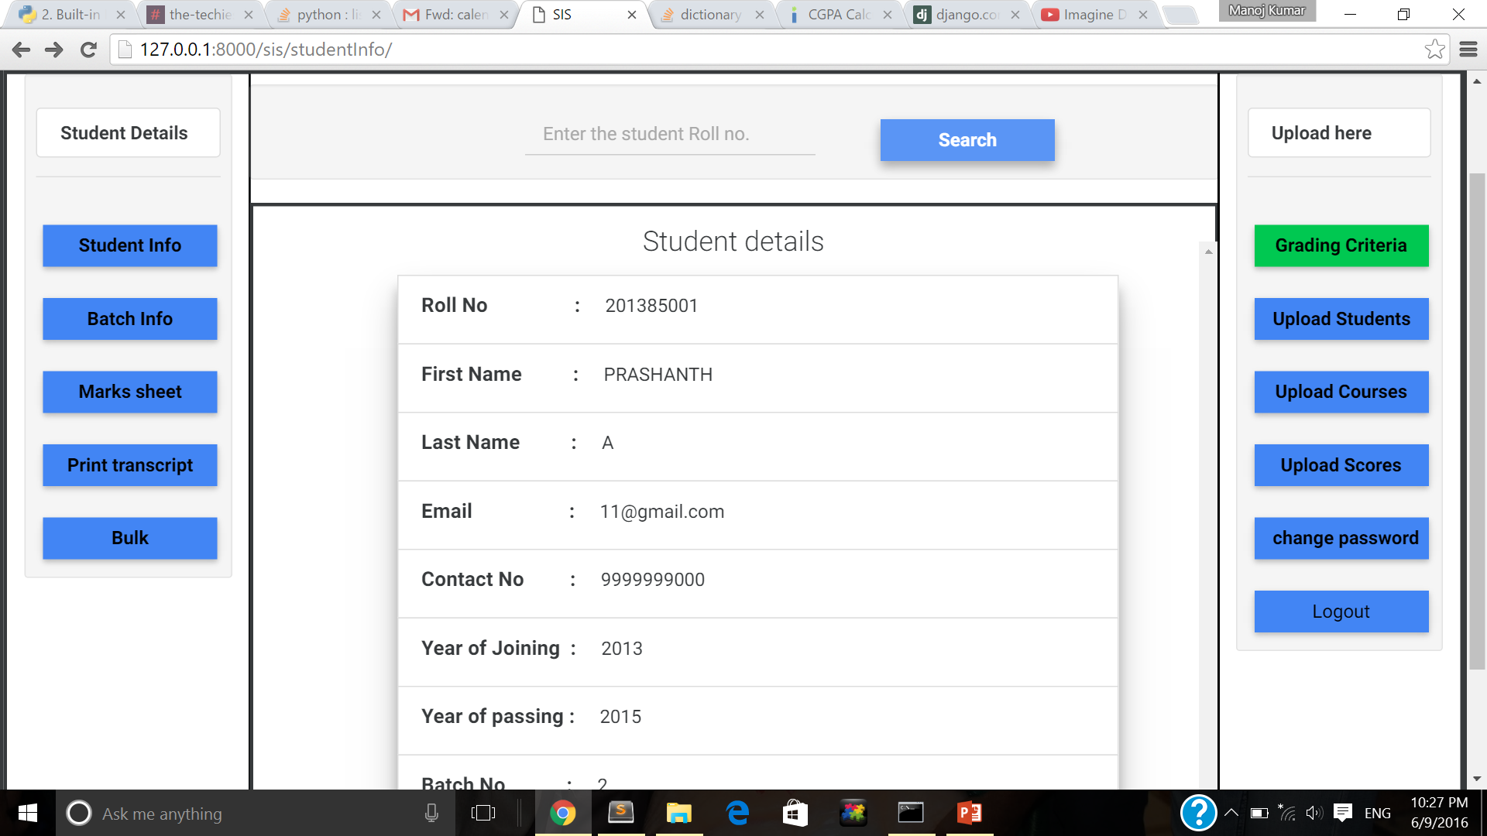
LANDING PAGE

Slide 4
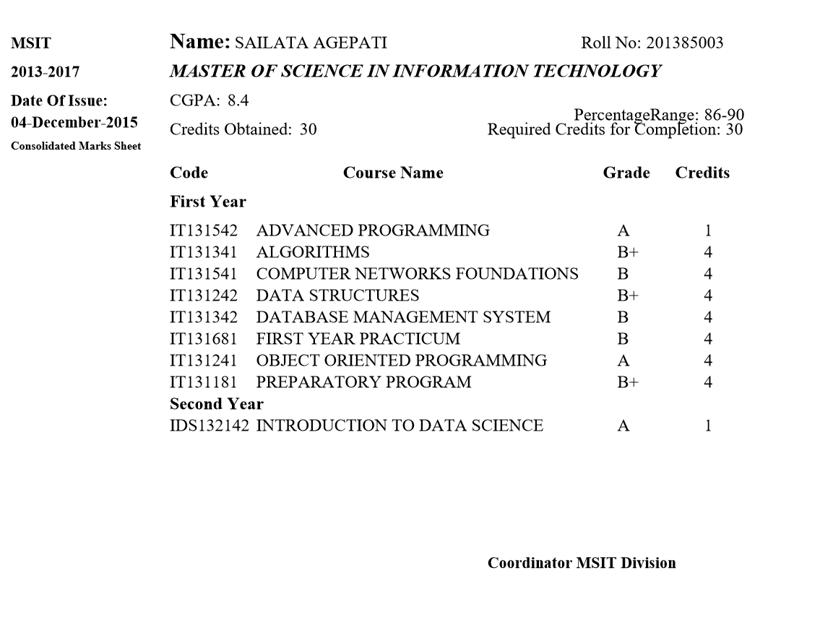

Slide 5
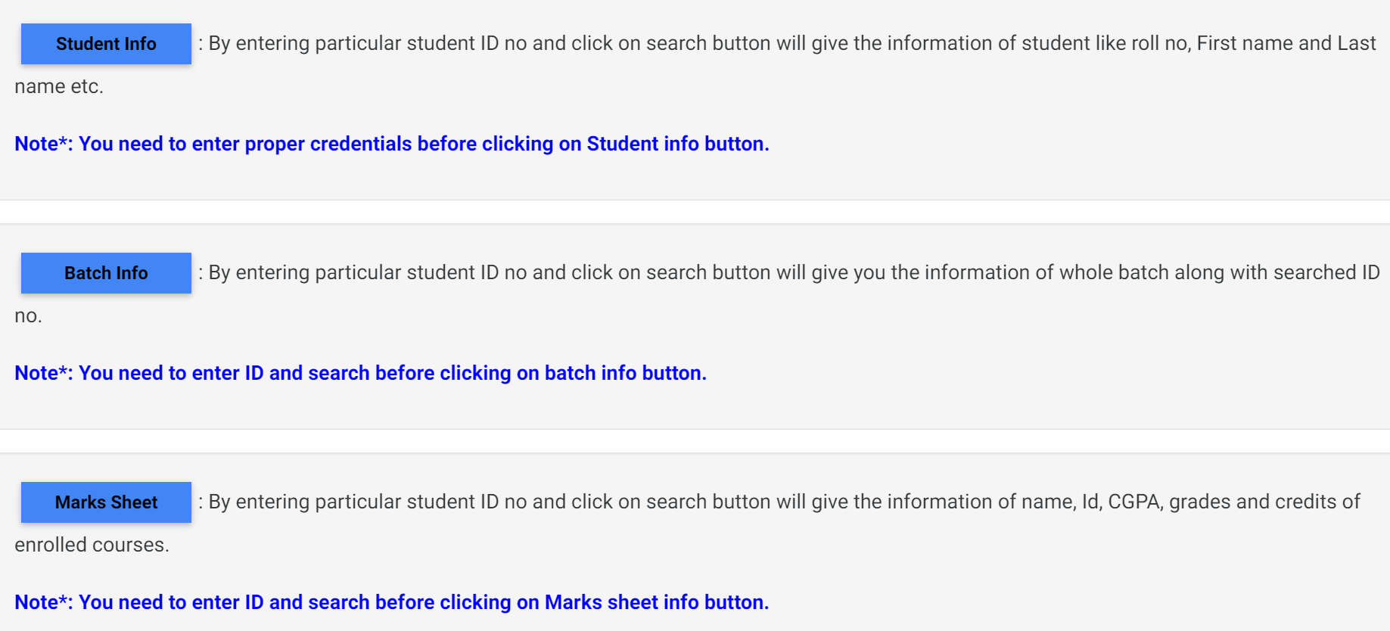
HELP-INFO

Slide 6
THANK YOU
9

